Slide 1
rohm bd71847 FAE 詢問電壓問題

Slide 2
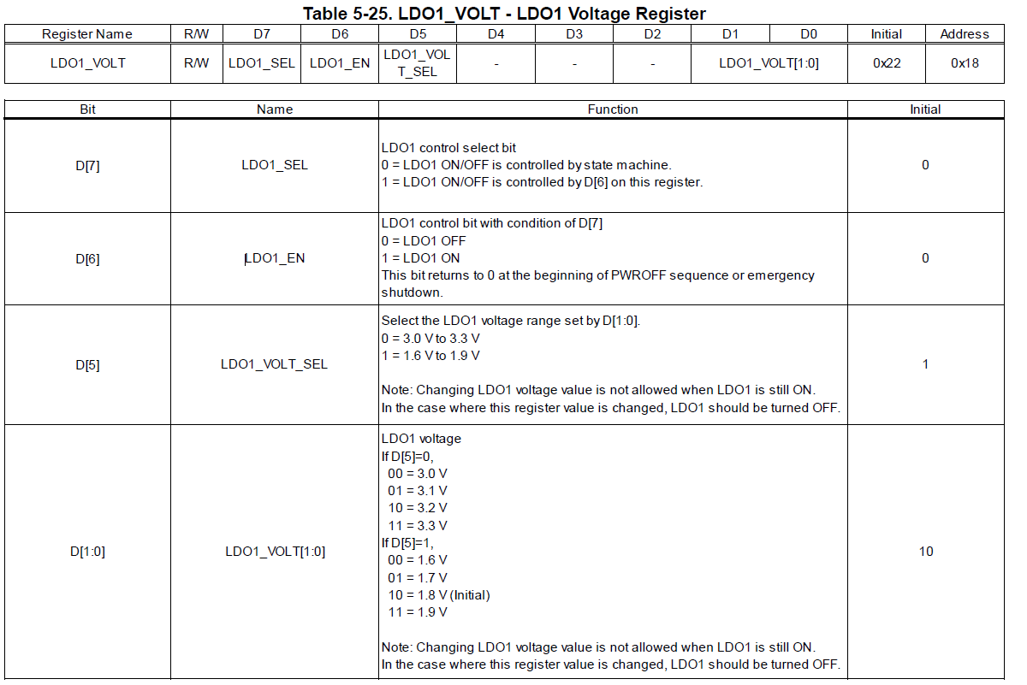
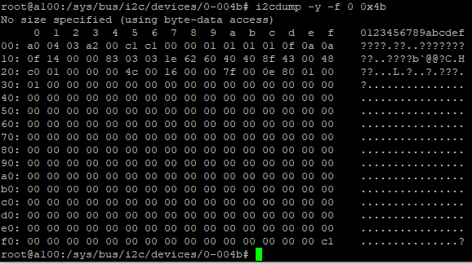
動作 : 請先下指令D[7]為1
行為 : platform 當機…shutdown

Slide 3

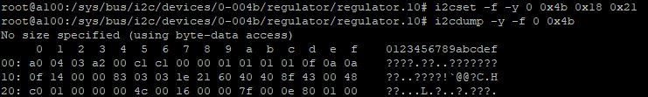
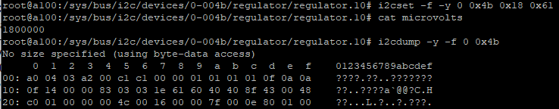
結論:
硬體 : 電壓 1.7 V 符合預期
軟體 : 顯示 1.8 V 跟實際不 match

Slide 4
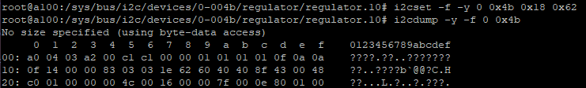
結論:
硬體 : 電壓 1.8 V 符合預期
軟體 : 顯示 1.8 V 符合預期

Slide 5

結論:
硬體 : 電壓 1.9 V 符合預期
軟體 : 顯示 1.8 V 跟實際不 match

Slide 6
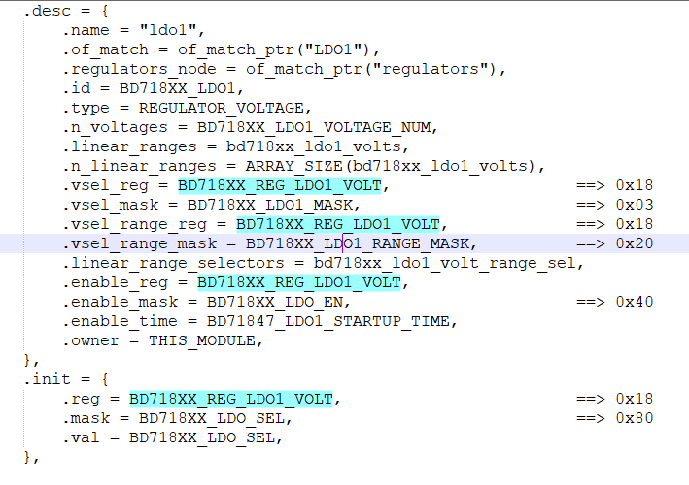
結論:
直接從 i2ctool 去更改 PMIC reg 硬體輸出是有達到預期
修改 driver 去更改沒有達到預期. 請 FAE 使否可以請內部
協助說明

Slide 7
U-boot 修改部分

Slide 8
修改原理
調整電壓 stop
程式碼
調整結果

Slide 9
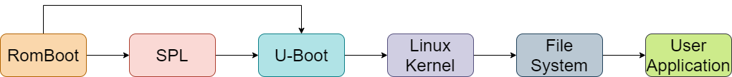
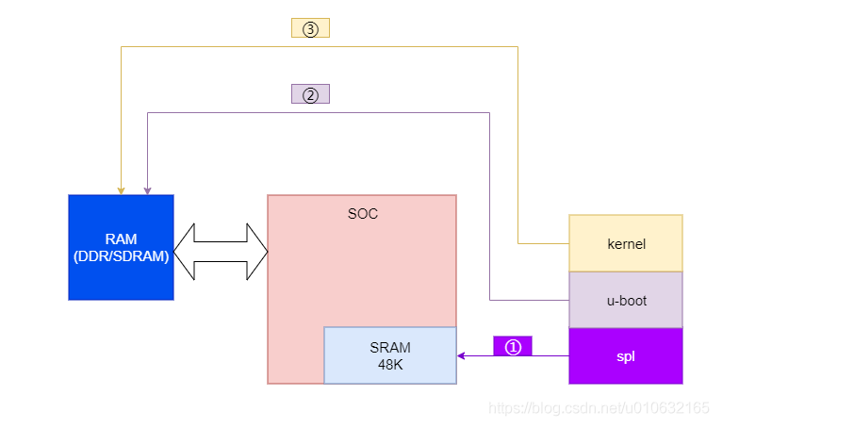
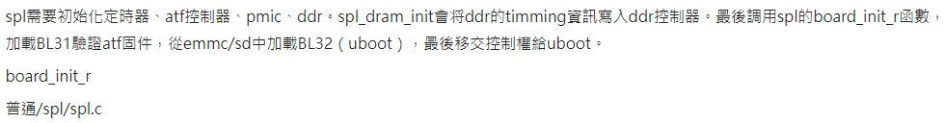
修改原理
Notes:
https://www.796t.com/content/1548154115.html

Slide 10
調整電壓 stop
名稱 | 原本電壓 | 電壓範圍
BUCK1 | 0.85 V | regulator-min-microvolt = <700000> / regulator-max-microvolt = <1300000>
BUCK2 | 0.85 V | regulator-min-microvolt = <700000> / regulator-max-microvolt = <1300000>
BUCK3 ➔ BUCK5 | 0.975 V | regulator-min-microvolt = <700000> / regulator-max-microvolt = <1350000>
BUCK4 ➔ BUCK6 | 3.3 V | regulator-min-microvolt = <3000000>/ regulator-max-microvolt = <3300000>
BUCK5 ➔ BUCK7 | 1.8 V | regulator-min-microvolt = <1605000>/ regulator-max-microvolt = <1995000>
BUCK6 ➔ BUCK8 | 1.1 V | regulator-min-microvolt = <800000> / regulator-max-microvolt = <1400000>
LDO1 | 1.8 V | regulator-min-microvolt = <1600000> / regulator-max-microvolt = <1900000>
LDO2 | 0.8 V | regulator-min-microvolt = <800000> / regulator-max-microvolt = <900000>
LDO3 | 1.8 V | regulator-min-microvolt = <1800000> / regulator-max-microvolt = <3300000>
LDO4 | 0.9 V | regulator-min-microvolt = <900000> / regulator-max-microvolt = <1800000>
LDO5 ( 空接)
LDO6 | 1.2 V | regulator-min-microvolt = <900000> / regulator-max-microvolt = <1800000>
Notes:
https://www.796t.com/content/1548154115.html

Slide 11
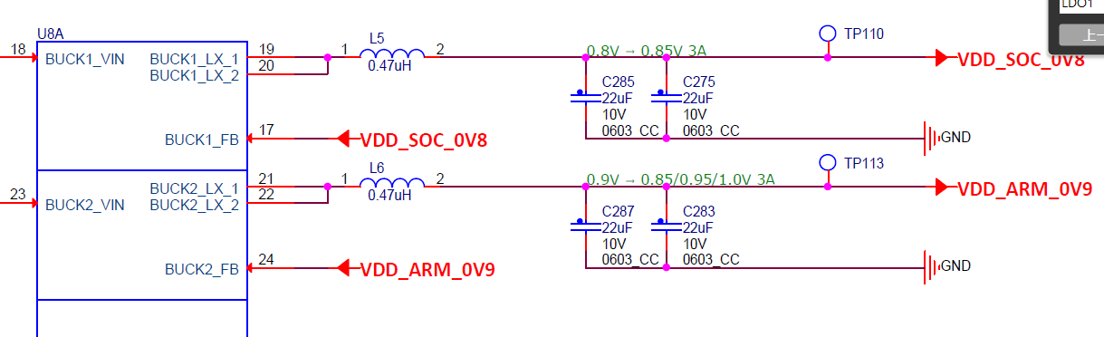
BLCK1 (regulator-min-microvolt = <700000> / regulator-max-microvolt = <1300000>)

Slide 12
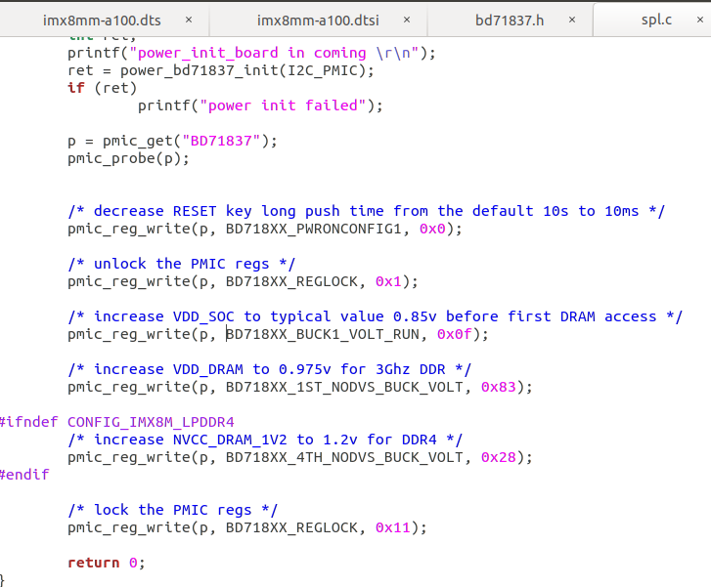
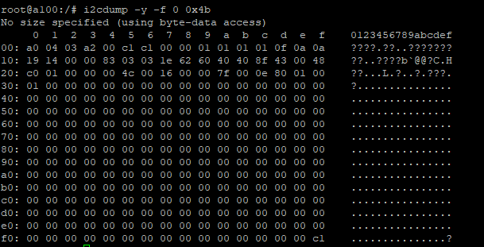
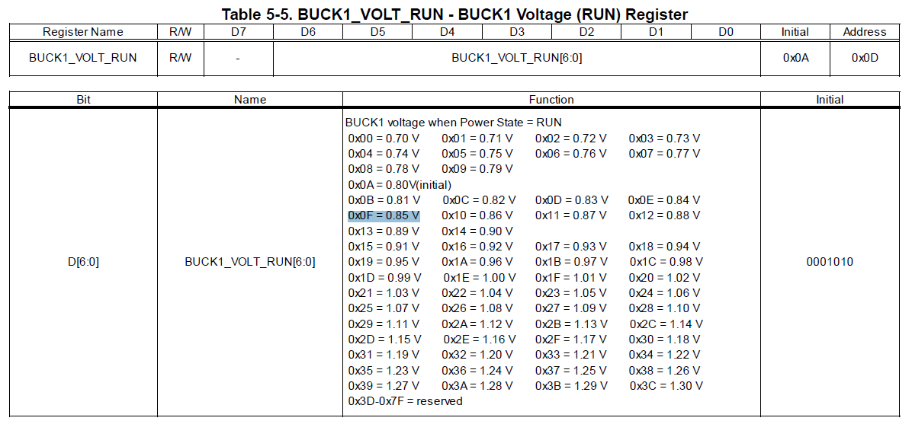

Slide 13
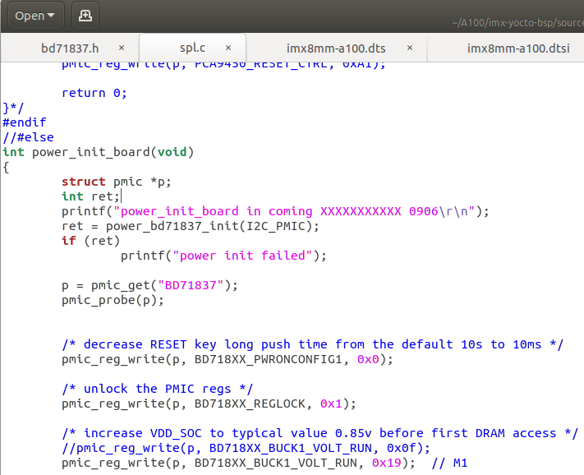
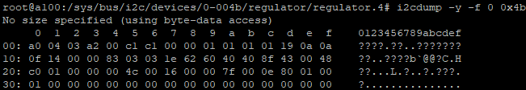

Slide 14
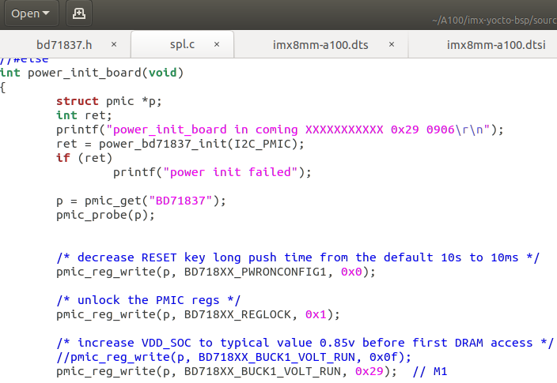
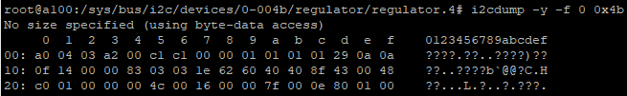
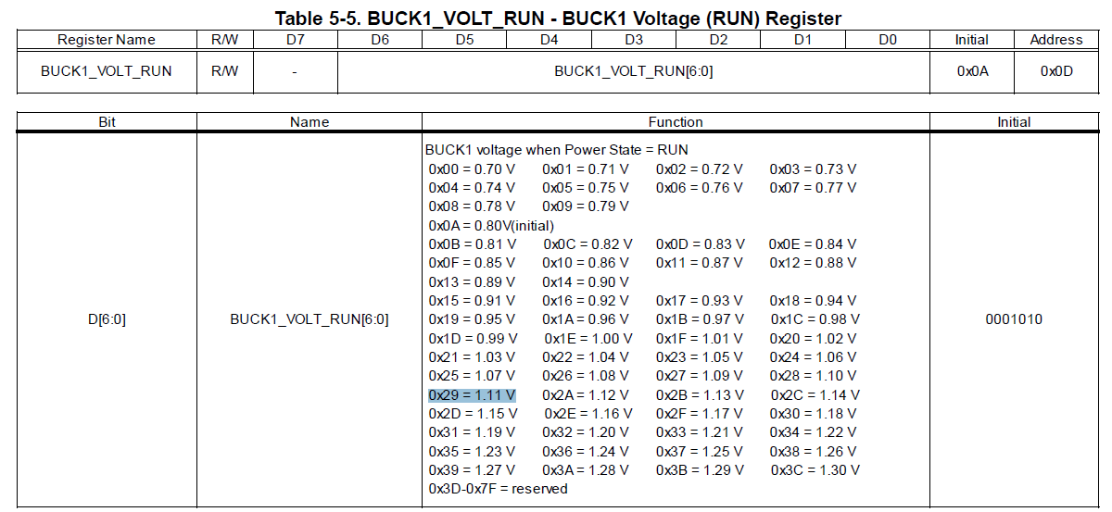

Slide 15
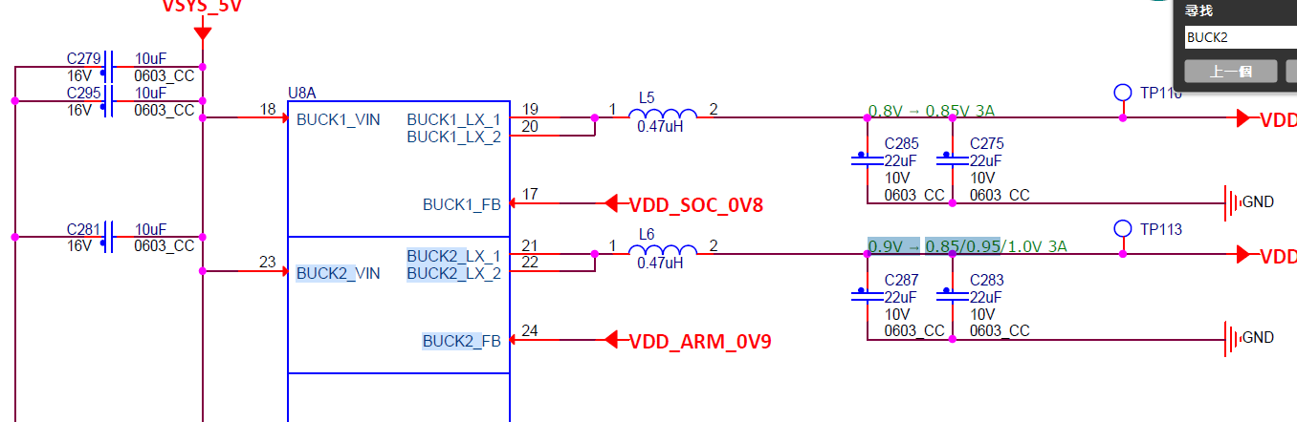
BLCK2 (regulator-min-microvolt = <700000> / regulator-max-microvolt = <1300000>)

Slide 16
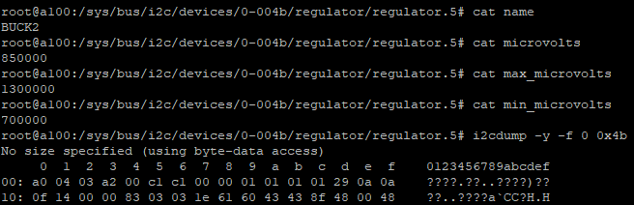
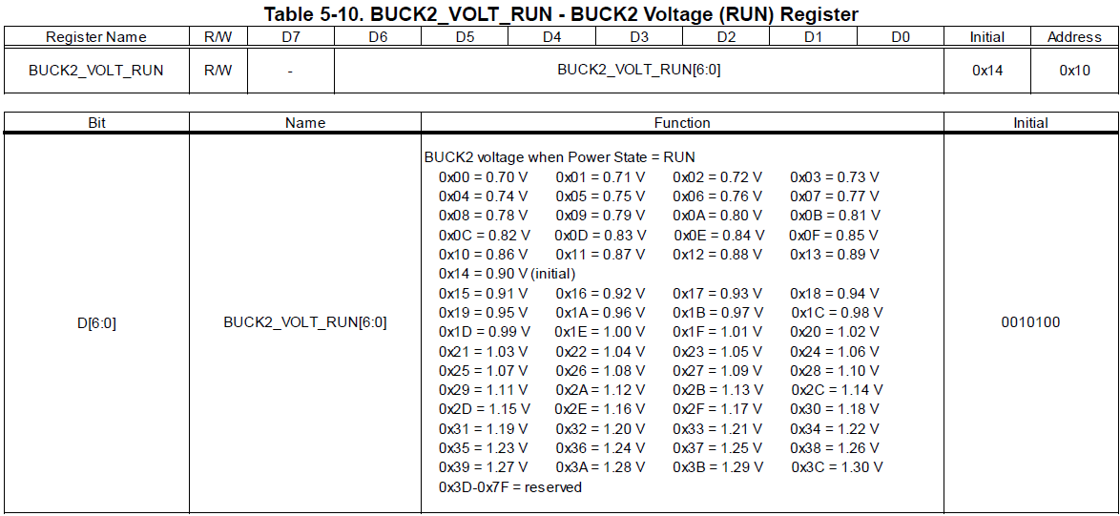

Slide 17
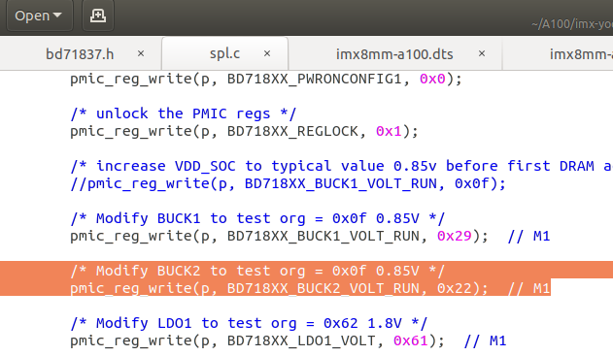
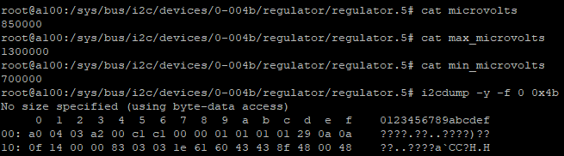
Ox22 寫不進去 IC

Slide 18
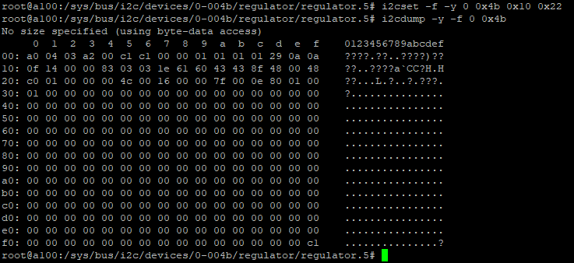

Slide 19
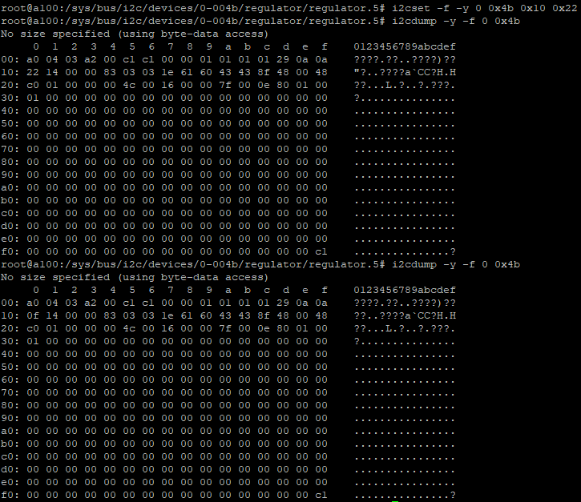

Slide 20
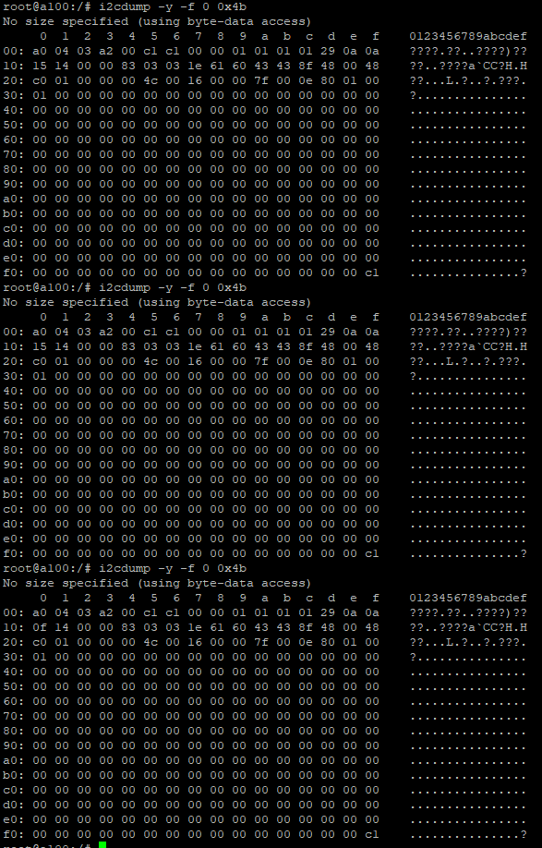
BUCK2 reg 寫入有問題
造成 driver 寫入異常

Slide 21
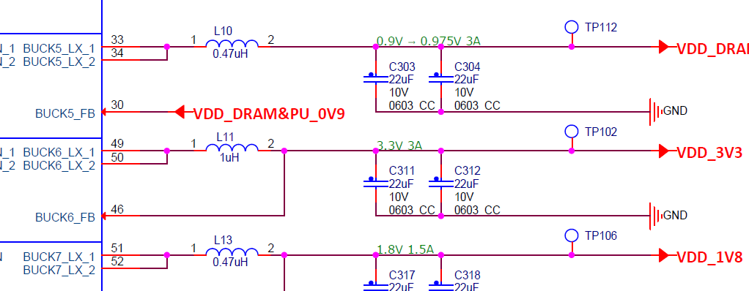
BLCK3➔ BLCK5 (regulator-min-microvolt = <700000> / regulator-max-microvolt = <1350000>)

Slide 22
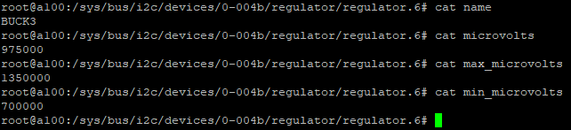
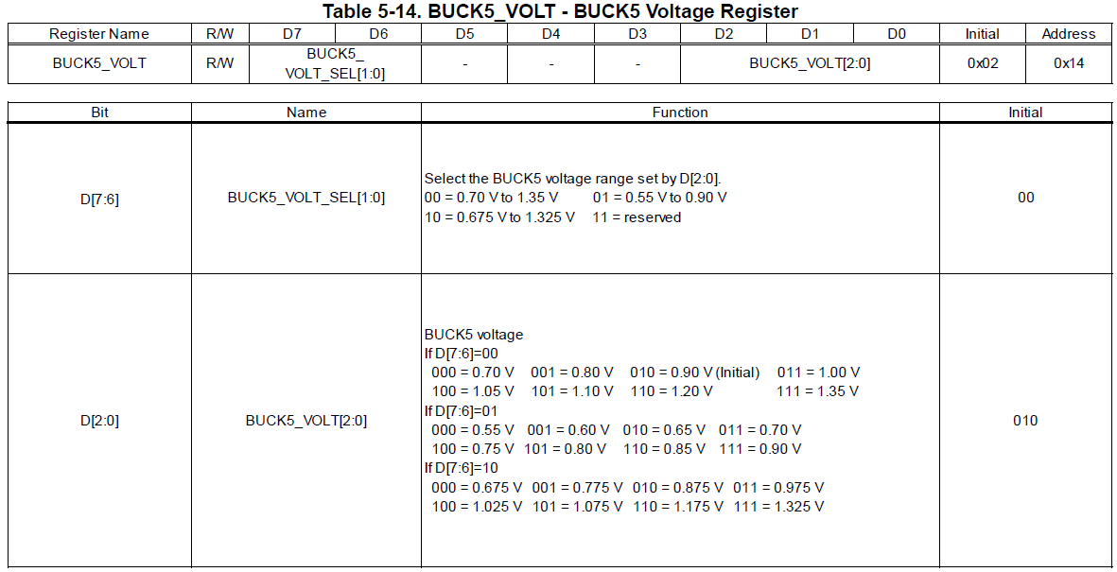

Slide 23
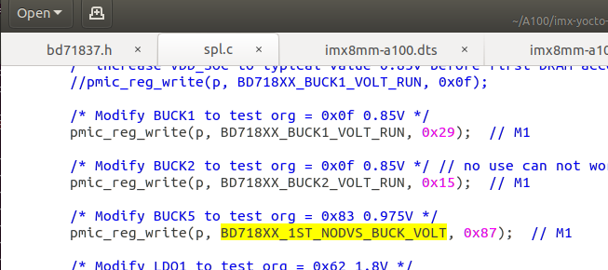
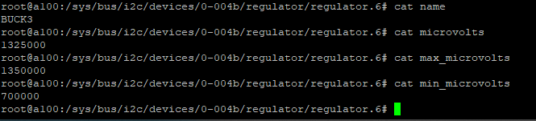

Slide 24
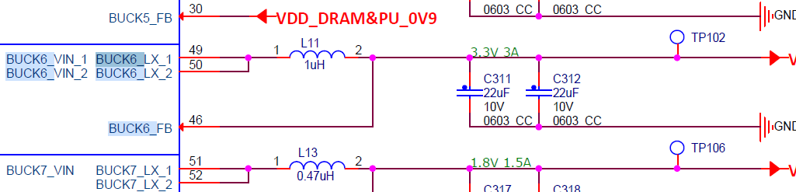
BLCK4➔ BLCK6 (regulator-min-microvolt = <3000000> / regulator-max-microvolt = <3300000>)

Slide 25
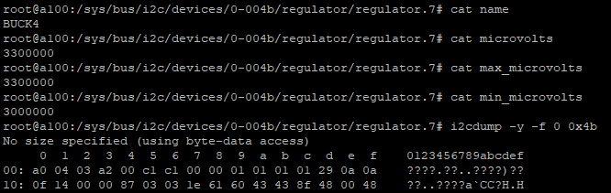
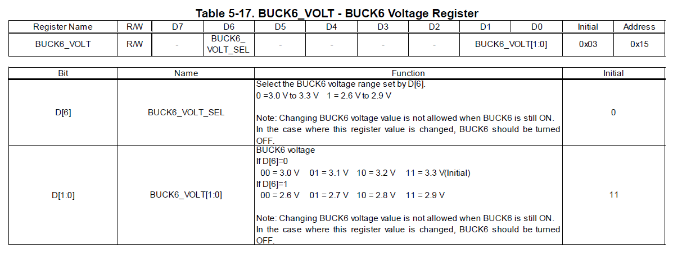

Slide 26
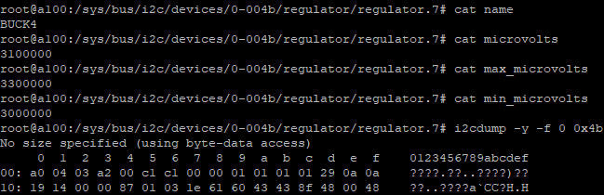

Slide 27
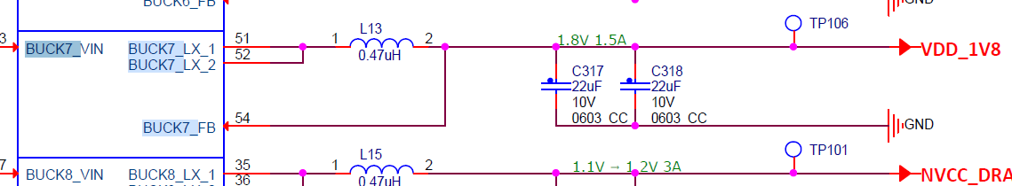
BLCK5➔ BLCK7 (regulator-min-microvolt = <1605000> / regulator-max-microvolt = <1995000>)

Slide 28
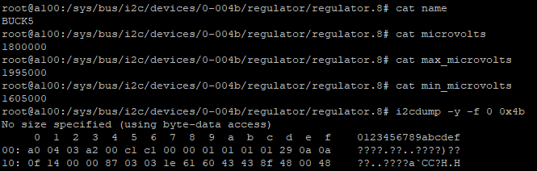
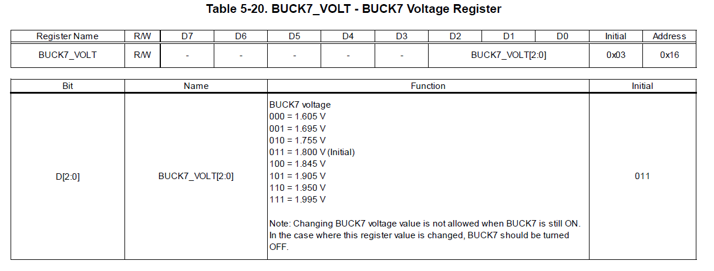

Slide 29
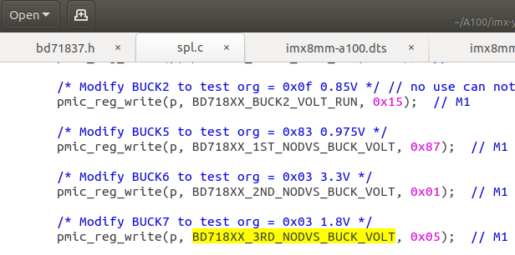
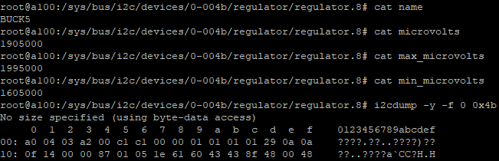

Slide 30
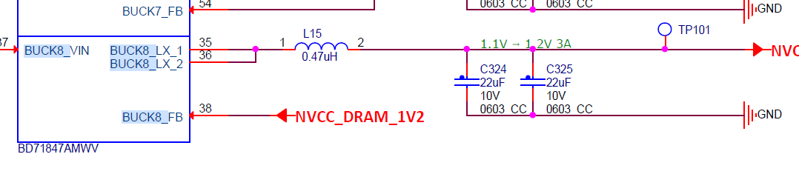
BLCK6➔ BLCK8 (regulator-min-microvolt = <800000> / regulator-max-microvolt = <1400000>)

Slide 31
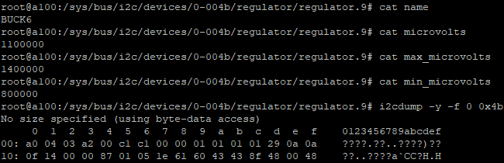
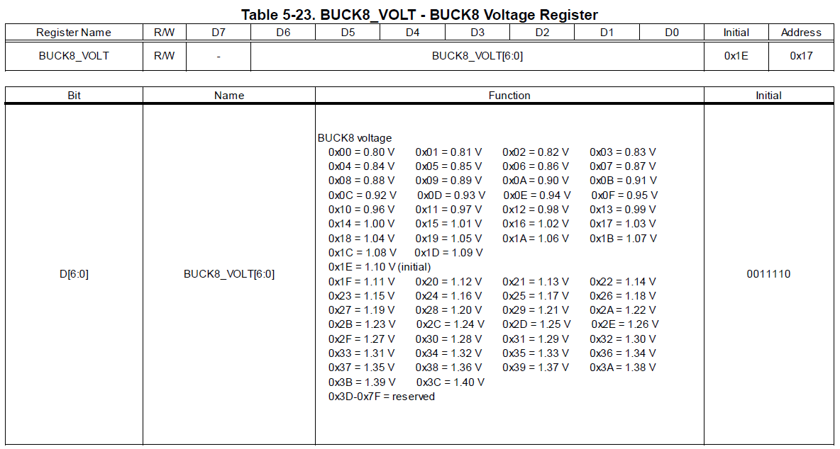

Slide 32
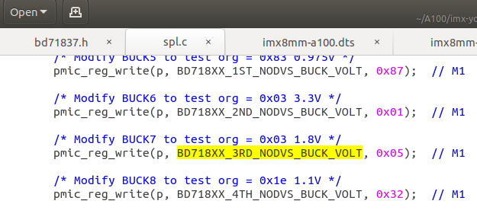
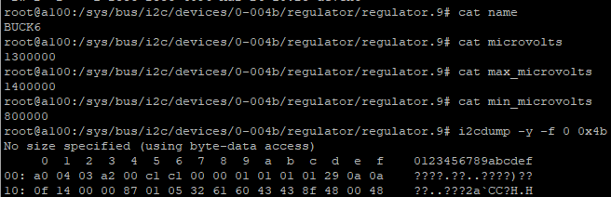

Slide 33
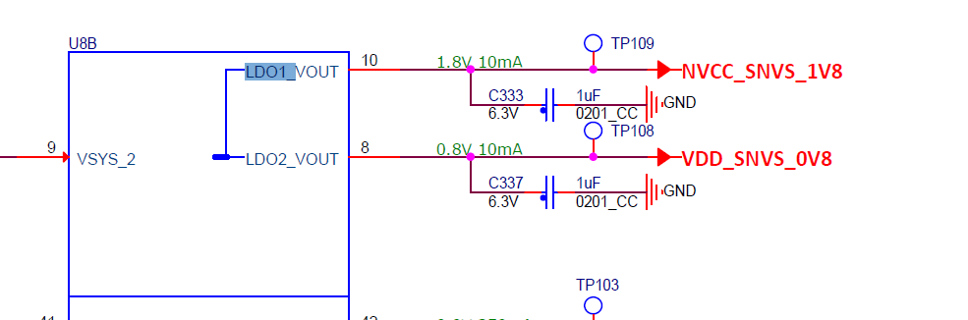
LDO1 (regulator-min-microvolt = <1600000> / regulator-max-microvolt = <1900000>)

Slide 34

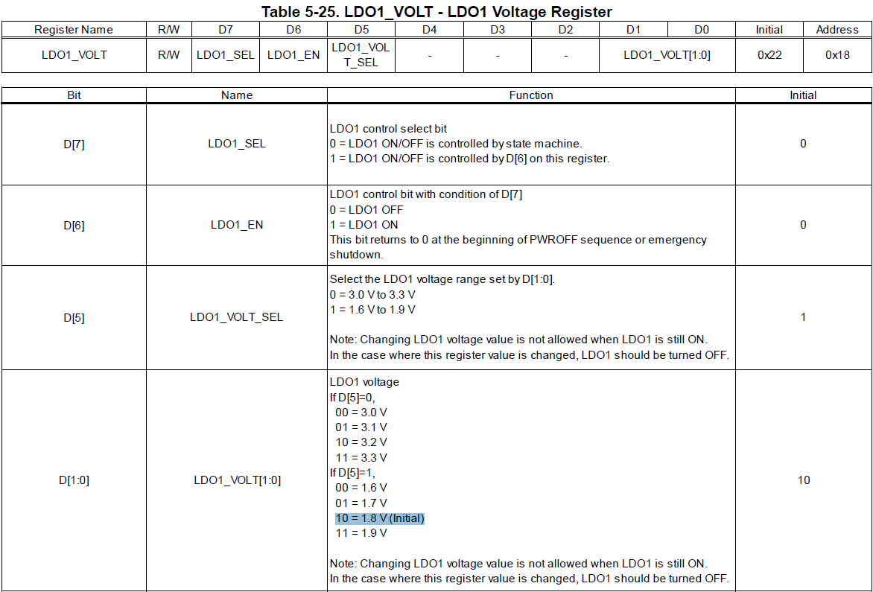
LDO1 (regulator-min-microvolt = <1600000> / regulator-max-microvolt = <1900000>;)

Slide 35
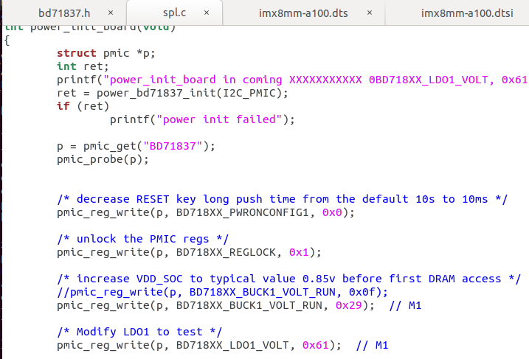


Slide 36
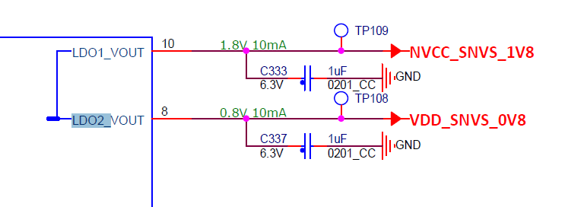
LDO2 (regulator-min-microvolt = <800000> / regulator-max-microvolt = <900000>)

Slide 37
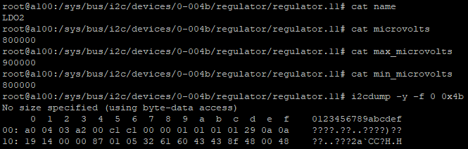


Slide 38



Slide 39

LDO3 (regulator-min-microvolt = <1800000> / regulator-max-microvolt = <3300000>)

Slide 40




Slide 41



Slide 42

LDO4 (regulator-min-microvolt = <900000> / regulator-max-microvolt = <1800000>)

Slide 43



Slide 44



Slide 45

LDO5 (空接)

Slide 46

LDO6 (regulator-min-microvolt = <900000> / regulator-max-microvolt = <1800000>)

Slide 47



Slide 48



Slide 49


程式碼

Slide 50

調整結果

Slide 51
名稱 | 原本電壓 | 調整電壓
BUCK1 | 0.85 V | 1.1 V
BUCK2 | 0.85 V | Reg 無法寫入
BUCK3 ➔ BUCK5 | 0.975 V | 1.325 V
BUCK4 ➔ BUCK6 | 3.3 V | 3.1 V
BUCK5 ➔ BUCK7 | 1.8 V | 1.905 V
BUCK6 ➔ BUCK8 | 1.1 V | 1.3 V
LDO1 | 1.8 V | 1.7 V
LDO2 | 0.8 V | 0.9 V
LDO3 | 1.8 V | 2.1 V
LDO4 | 0.9 V | 1.2 V
LDO5 ( 空接)
LDO6 | 1.2 V | 1.7 V

